Slide 1

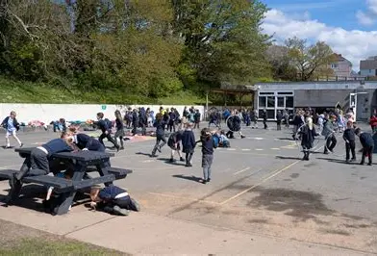

Welcome to Mary Dean's CE Primary School and Nursey.
Website link: https://www.marydeans.plymouth.sch.uk/

Slide 2
Passport in Year 5/6
Mrs. Mills/Mrs. Baker

Slide 3

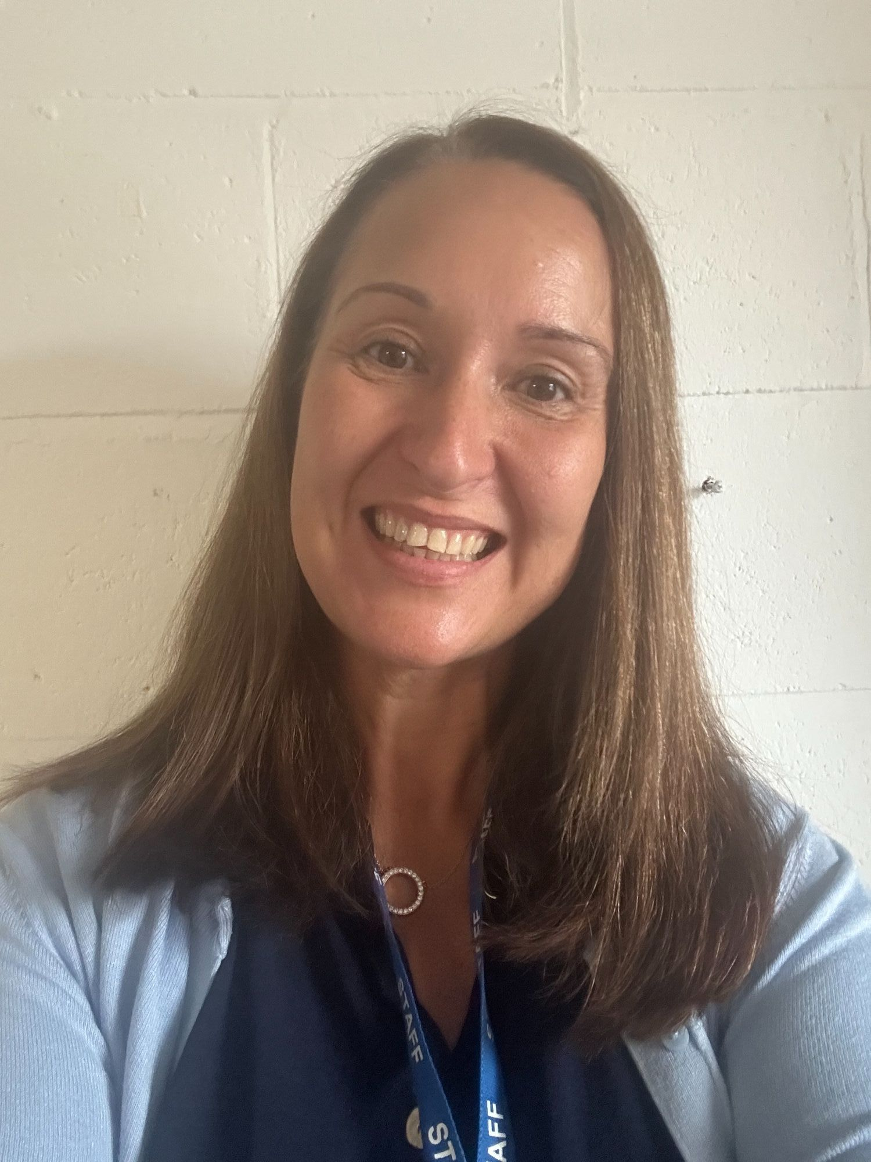
In September, our Head Teacher will be
Miss Garside.

Slide 4

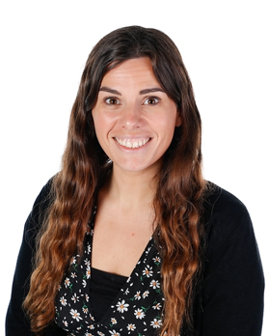
Our Deputy Head Teacher will be
Mrs. Evans.

Slide 5
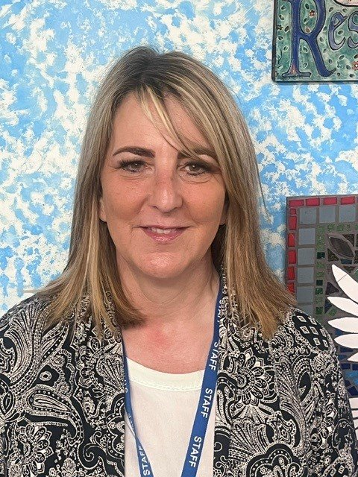

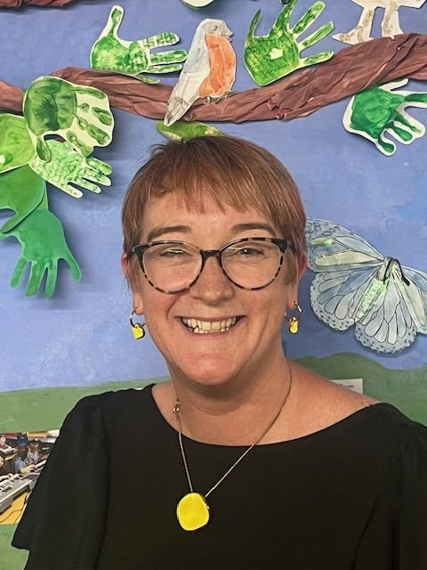
Our Assistant Head Teachers will be Mrs. Higginson and Mrs. Lewis.

Slide 6


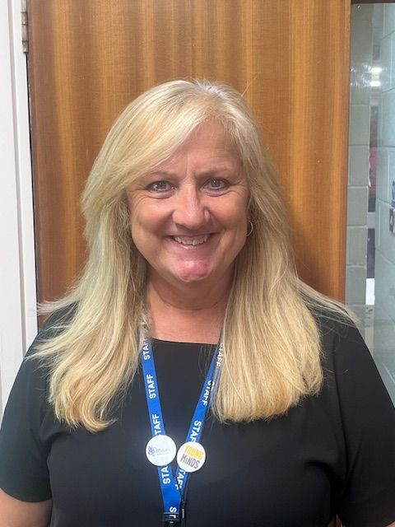
Our Safeguarding team are:
DSL
Miss Garside
DDSL
Mrs Evans
DDSL
Mrs Higginson
DDSL
Mrs Lewis
DDSL
Mrs Blake

Slide 7

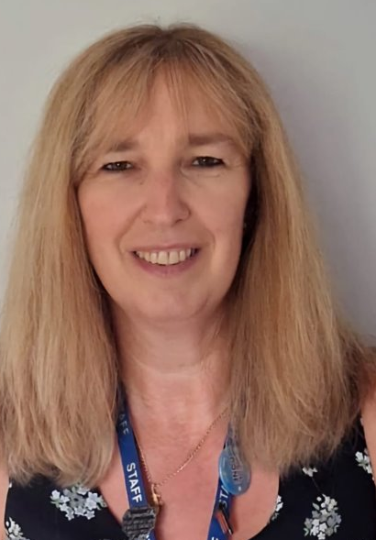
Our SENDCo is:
Our TA intervention lead is Mrs Lealand
Key links:
Local offer:
https://www.plymouthonlinedirectory.com/article/182/SEND-Local-Offer
PIAS: https://www.plymouthias.org.uk/
GATI: https://plymouthgati.co.uk/specialist/plymouth-city-council-statutory-send-team/
PPCV: https://plymouthpcv.co.uk/
CAMHS: https://www.livewellsouthwest.co.uk/camhs-early-help-pathway
Mrs Higginson

Slide 8

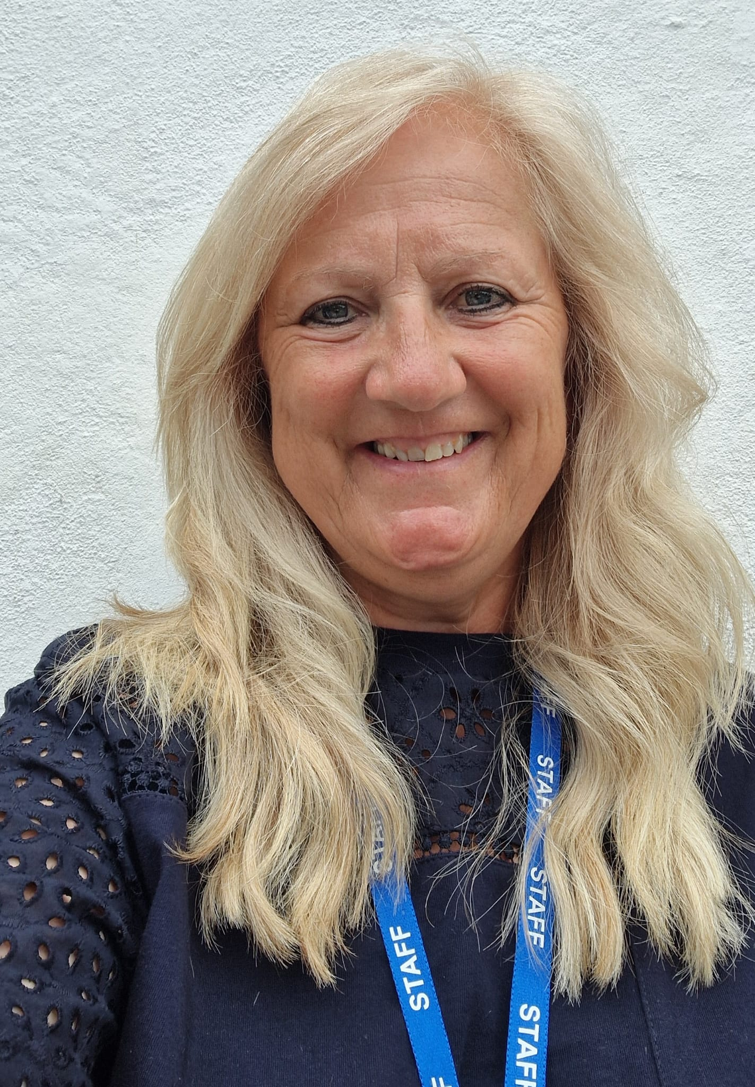
Our Family Support Worker is Mrs. Blake.

Slide 9

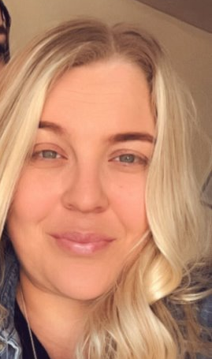
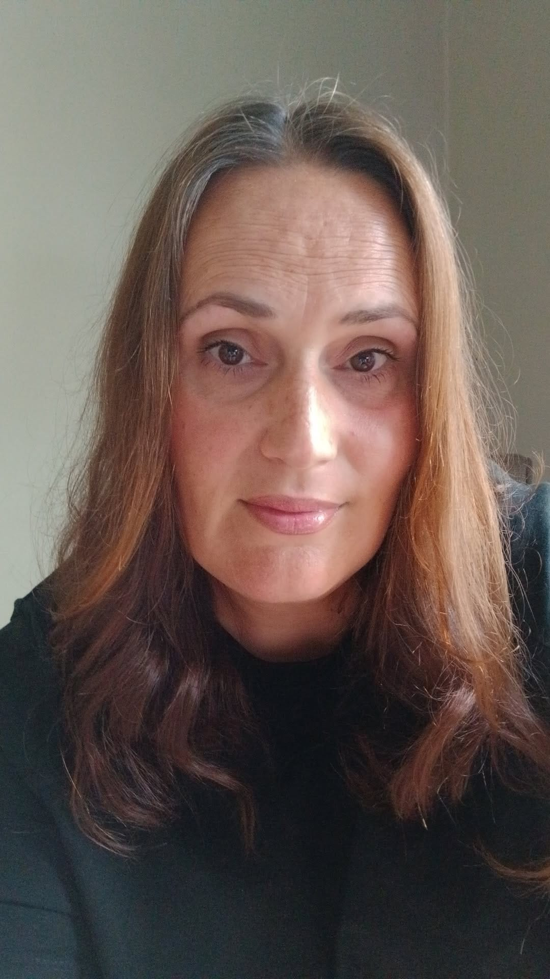
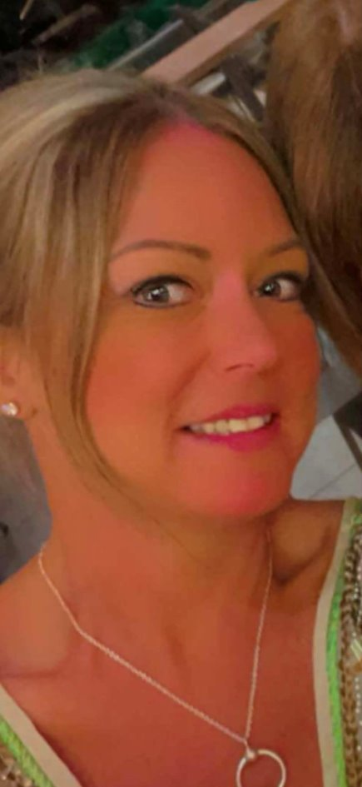
Our administration team are:
Mrs Lewis
Senior Administrator
Mrs Parsons
Ms Tunley
Contact: office@marydeans.plymouth.sch.uk

Slide 10
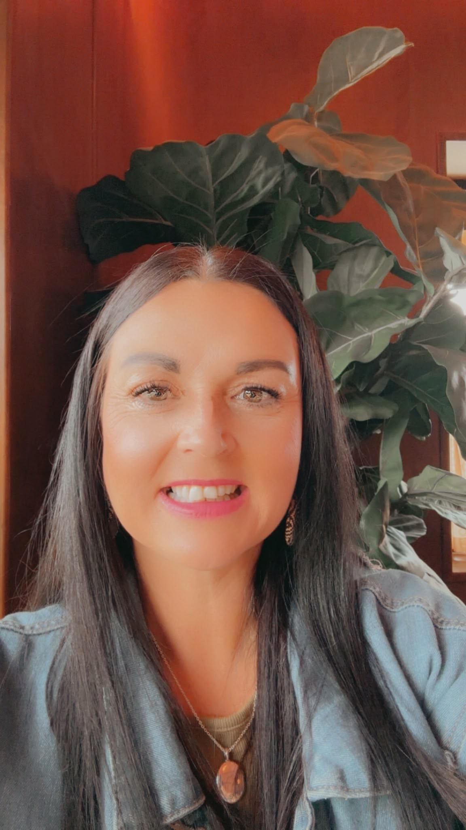

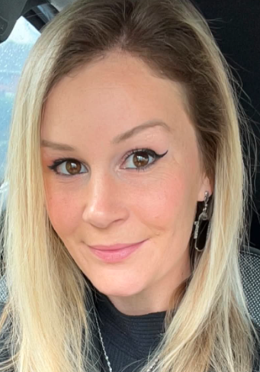
Next year, my class teachers will be:
Mrs Mills
Mon/Tuesday/Wednesday & Thursday morning.
Mrs Baker
Thursday PM/Friday all day.

Slide 11

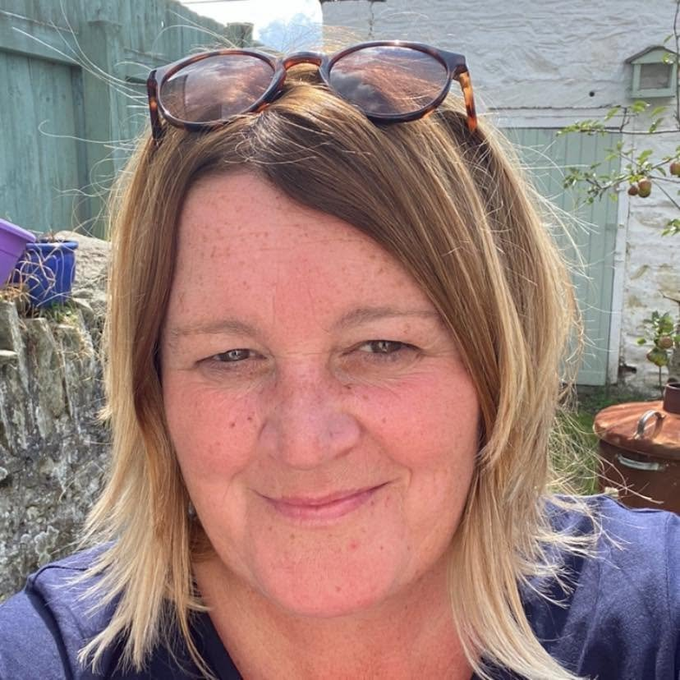
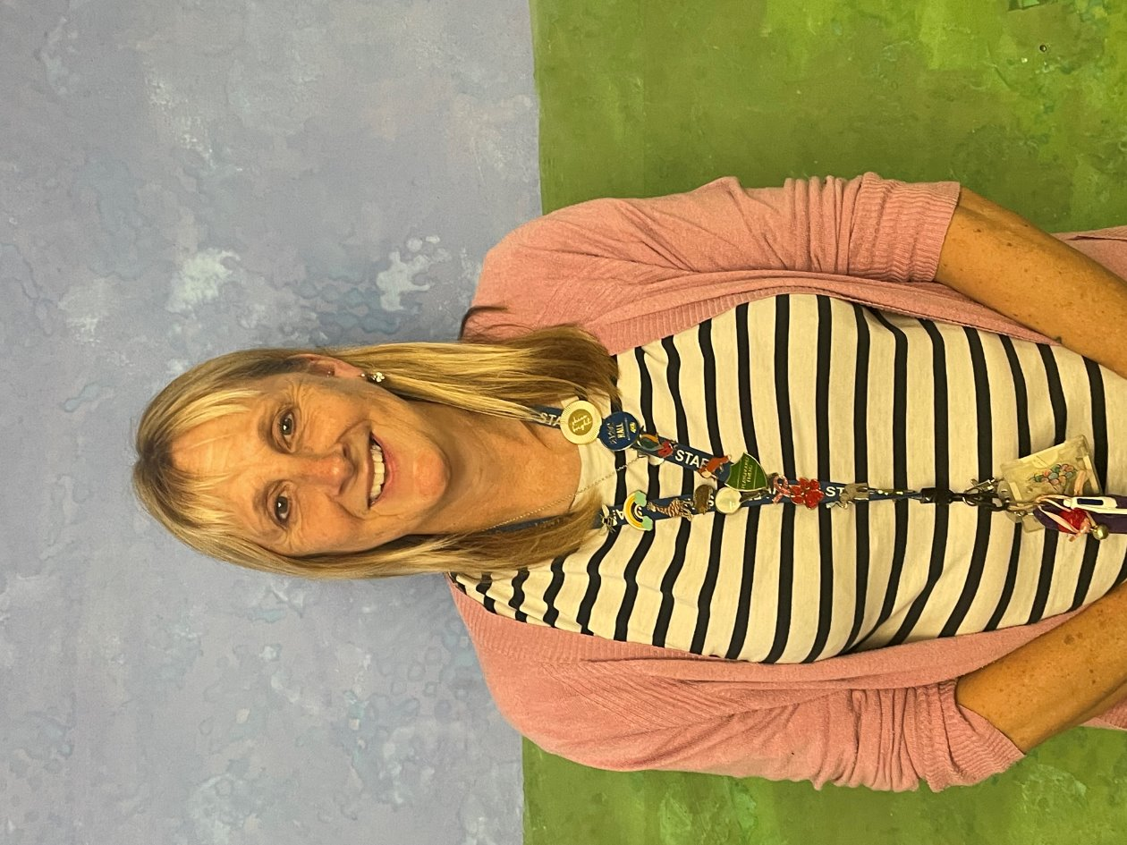
The other adults supporting me will be:
Mrs Costin /Miss Jacks
Teaching Assistants.

Slide 12

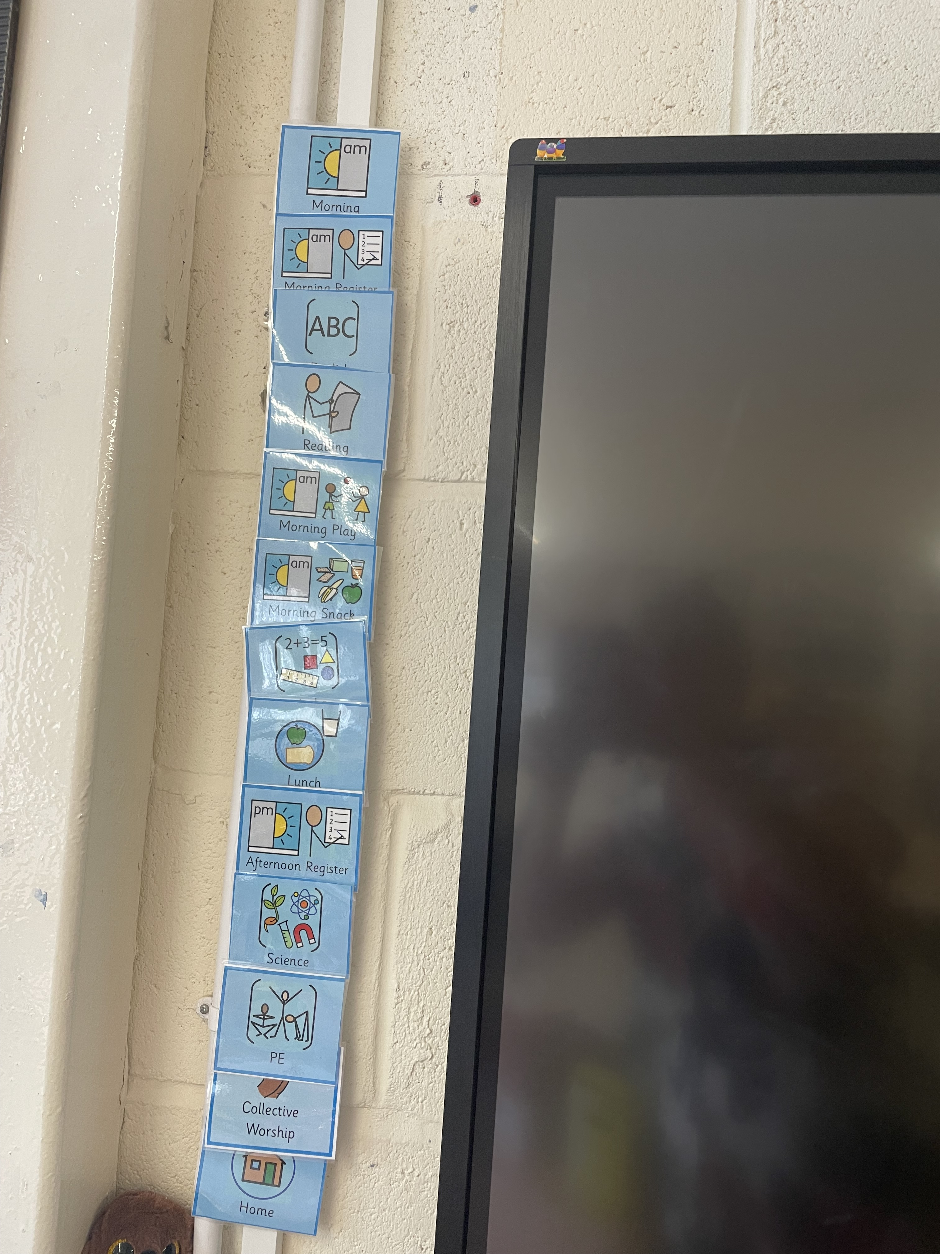
I will be able to find out what I’m doing each day by looking at the timetable.
The pictures will be the same and it will be next to the whiteboard.

Slide 13

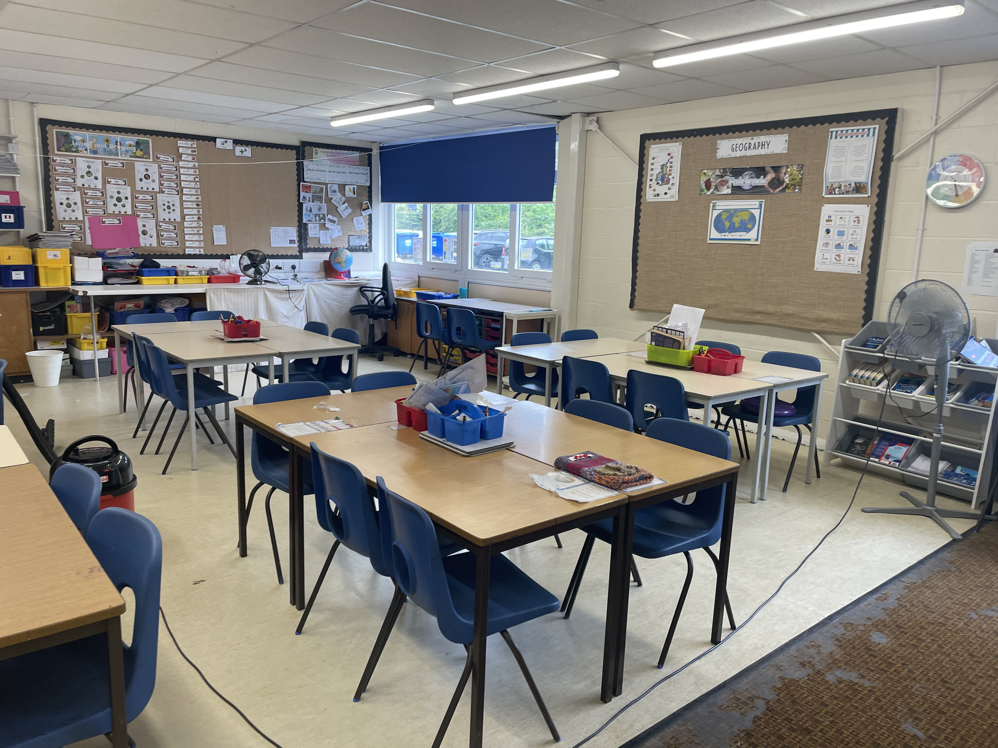
This is my classroom.

Slide 14

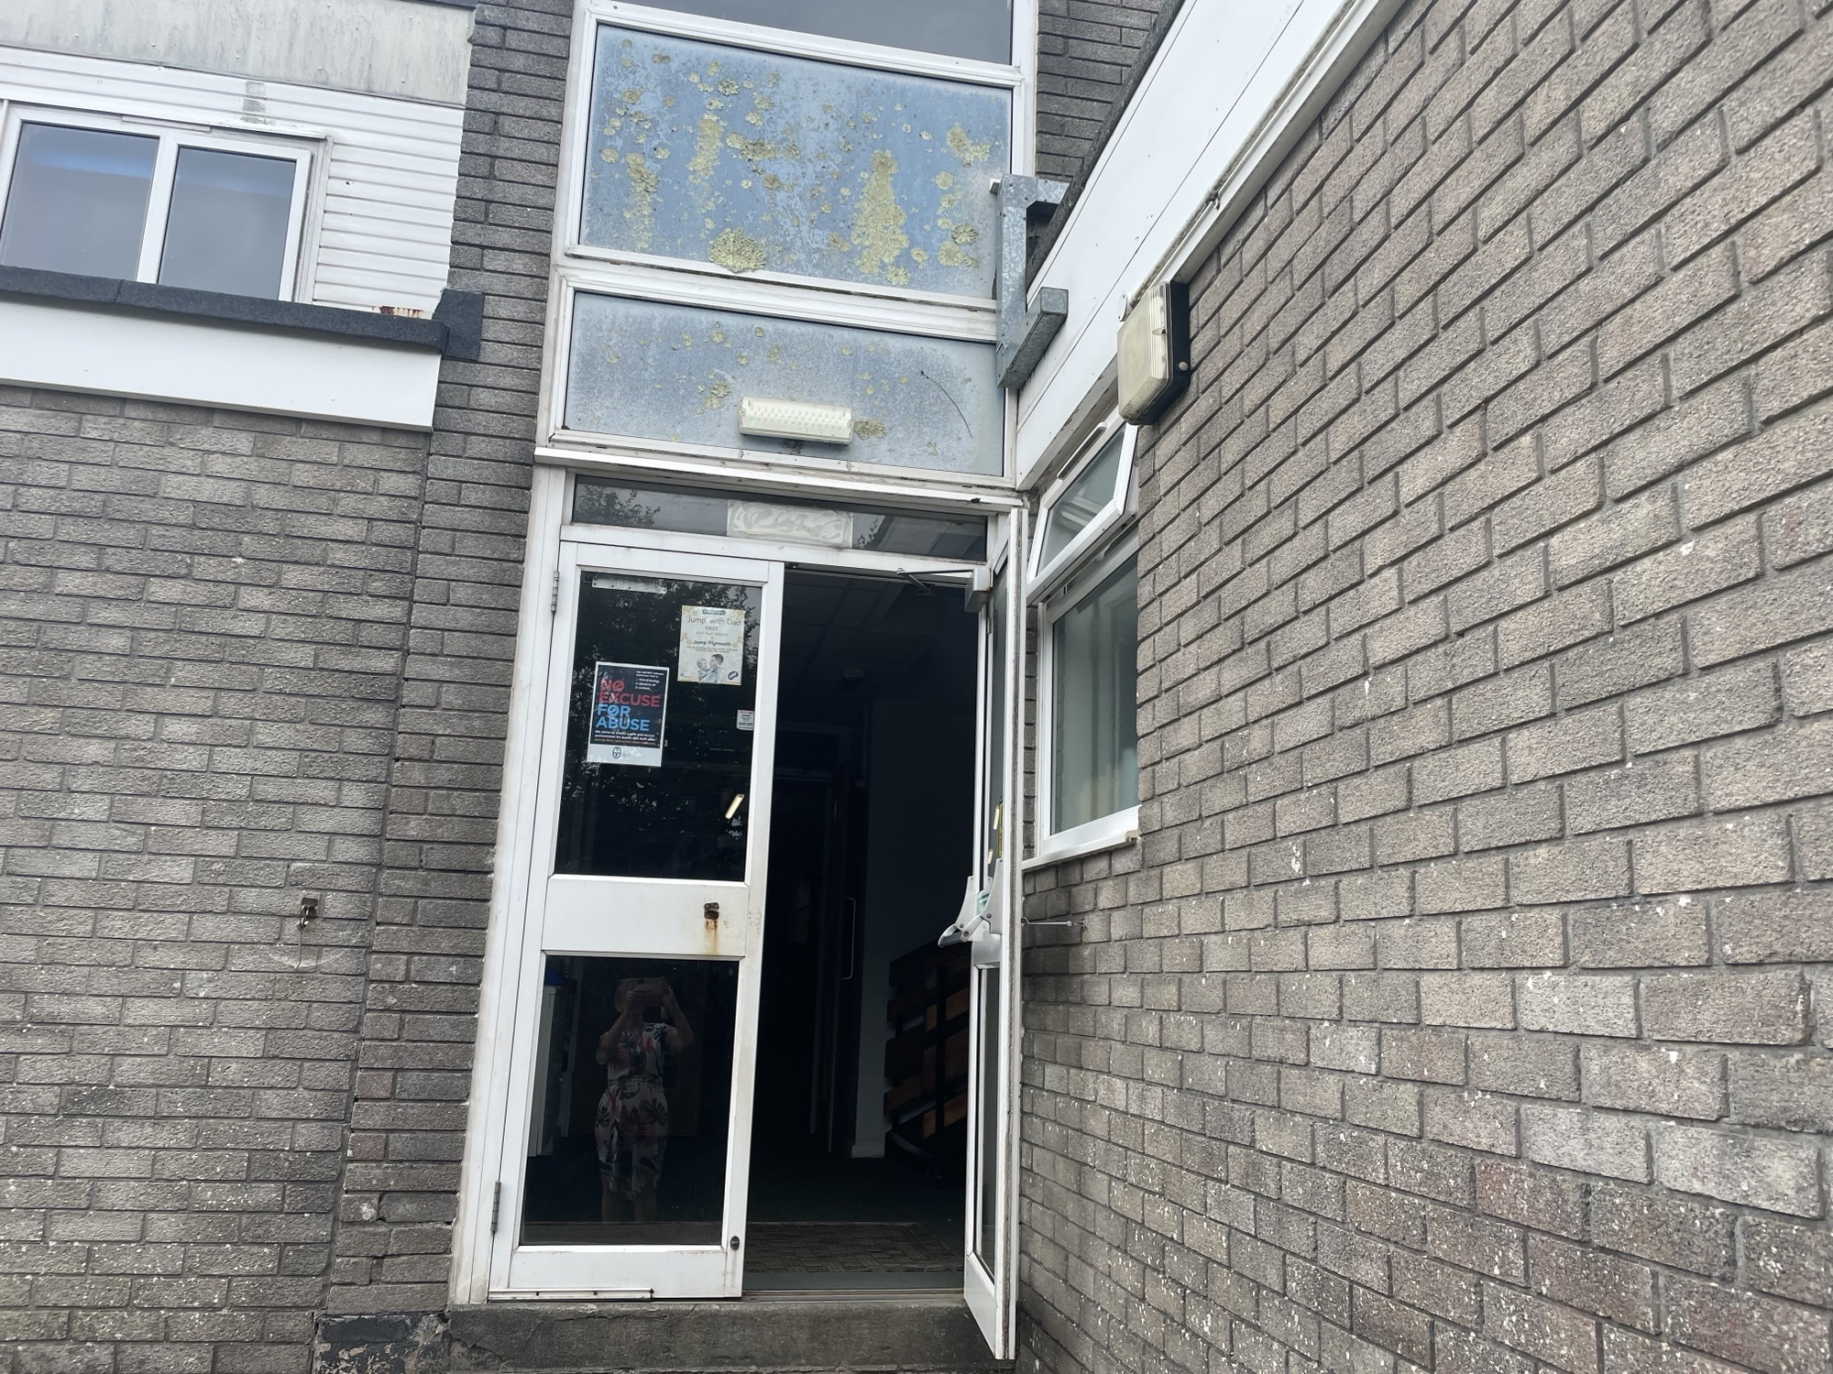
I will enter through the outside door.
This will also be where I leave for break time and at the end of the day.

Slide 15

Things that will be the same:
School rules.
Bring my coat and water bottle.
I will learn maths and English every day.
Break time and lunch times will be the same.
I will be in my class with some children I know.
I will wear my PE kit on PE days.
I will still read to an adult at home every day.
I will still have spellings to learn at home.

Slide 16

Things that might be different:
New classroom.
I might have a new talk partner.
PE will be on different days.
I might have playtime in a different playground.
I may have new adults supporting me.

Slide 17



Everyone feels excited and nervous when they are starting something new.
It’s OK to ask questions.
Adults and friends will help you.
You can ask them for help or ask them a question if you are unsure about something.

Slide 18



You will soon settle in and enjoy the new things that you do.
Soon it will seem like an ‘old’ classroom not a new one!!
Well done!
You are on the way to being ready for the next school year.

